Slide 1
Student Name : PRAVEEN S M
Final Project : HEART DISEASE PREDICTION

Slide 2
PROJECT TITLE : HEART DISEASE PREDICTION USING DEEP LEARNING

Slide 3


AGENDA: 1. Introduction to Heart Disease 2. Machine Learning in Healthcare 3. Data Collection and Preprocessing 4. Feature Selection and Engineering 5. Model Development 6. Model Evaluation and Validation 7. Deployment and Integration 8. Ethical and Regulatory Considerations 9. Future Directions and Challenges 10.Case Studies and Success Stories
3/21/2024 Annual Review

Slide 4

PROBLEM STATEMENT: Objective: Develop a machine learning model to accurately predict the likelihood of heart disease based on patient data, enabling early detection and personalized intervention strategies. Approach: Gather and preprocess clinical data, select informative features, train and evaluate machine learning algorithms, and deploy the model for real-time risk assessment by healthcare professionals. Impact: Enhance early detection, risk stratification, and personalized patient care, ultimately contributing to the reduction of heart disease morbidity and mortality on a global scale.

Slide 5

PROJECT OVERVIEW: The heart disease prediction project successfully developed a machine learning model to predict the likelihood of heart disease based on individual patient data. Achievements include robust data collection, model development using various algorithms, rigorous evaluation, and deployment for real-time risk assessment. Strengths lie in the collaborative approach, methodological rigor, and potential real-world impact on patient outcomes. Areas for improvement include enhancing model interpretability, addressing data imbalance, and integrating mechanisms for long-term monitoring. Future directions include exploring advanced technologies, collaboration for validation, and expansion to other cardiovascular conditions. Overall, the project represents a significant advancement in proactive healthcare intervention and personalized patient care.

Slide 6
WHO ARE THE END USERS? Healthcare Professionals: Cardiologists, general practitioners, nurses, and other healthcare professionals utilize predictive models to assess the risk of heart disease in patients during routine check-ups or diagnostic evaluations. Patients: Individuals concerned about their cardiovascular health can benefit from heart disease prediction models by gaining insights into their risk factors and taking proactive steps to mitigate them. Healthcare Systems and Institutions: Healthcare systems and institutions can leverage heart disease prediction models to optimize resource allocation, prioritize high-risk patients for preventive interventions, and tailor population health management strategies. Public Health Agencies: Public health agencies utilize heart disease prediction models to monitor population-level trends, identify disparities in cardiovascular health outcomes, and develop targeted interventions to reduce the burden of heart disease on a community or national level. Researchers and Academia: Researchers and academics utilize heart disease prediction models to advance scientific knowledge, develop new predictive algorithms, and conduct epidemiological studies to understand the underlying risk factors and mechanisms of heart disease.

Slide 7

YOUR SOLUTION AND ITS VALUE PROPOSITION: Our machine learning-based heart disease prediction model analyzes individual patient data to accurately assess the likelihood of heart disease. Early Detection: Enables timely intervention and preventive measures. Personalized Risk Assessment: Tailored risk assessment for individual patients. Proactive Intervention: Identifies high-risk patients for targeted interventions. Optimal Resource Allocation: Efficient utilization of healthcare resources. Empowering Patients: Provides insights for informed decision-making. Research and Innovation: Contributes to advancing cardiovascular disease prevention and management.

Slide 8
THE WOW IN YOUR SOLUTION: Our solution isn't just about predicting heart disease; it's about transforming healthcare with simplicity and impact: Instant Insights: Our model delivers lightning-fast predictions, providing immediate insights into heart disease risk with unparalleled speed and accuracy. Personalized Precision: Tailored to each individual, our solution doesn't offer one-size-fits-all predictions. Instead, it provides personalized risk assessments, ensuring precision that's unmatched in traditional risk evaluation methods. Empowering Simplicity: With a user-friendly interface, our solution makes complex predictive analytics accessible to everyone, from healthcare professionals to patients, empowering them to take proactive steps toward better heart health. Continuous Advancement: We're not satisfied with just meeting expectations; we're constantly innovating and refining our solution to exceed them. Our commitment to continuous improvement ensures that our model stays ahead of the curve in heart disease prediction. Life-Saving Impact: Beyond just numbers and data, our solution has the potential to save lives. By detecting heart disease early and enabling timely interventions, it's not just a predictive tool—it's a beacon of hope for better health outcomes.

Slide 9
MODELLING: Heart Disease Prediction Modeling Overview: Data Preparation: Cleanse data: Handle missing values and outliers. Normalize features: Ensure uniform scale across variables. Feature Selection: Identify relevant features: Select informative predictors. Remove irrelevant features: Exclude noise to improve model efficiency. Model Selection: Choose appropriate algorithms: Logistic Regression, Decision Trees, Random Forests, etc. Consider ensemble methods: Boosting or bagging for enhanced performance. Model Evaluation: Assess performance: Use metrics like accuracy, precision, recall, and AUC. Validate with cross-validation: Ensure robustness and generalizability. Deployment: Integrate into interface: Implement model for real-time risk assessment. Monitor and update: Continuously evaluate and refine model performance.

Slide 10
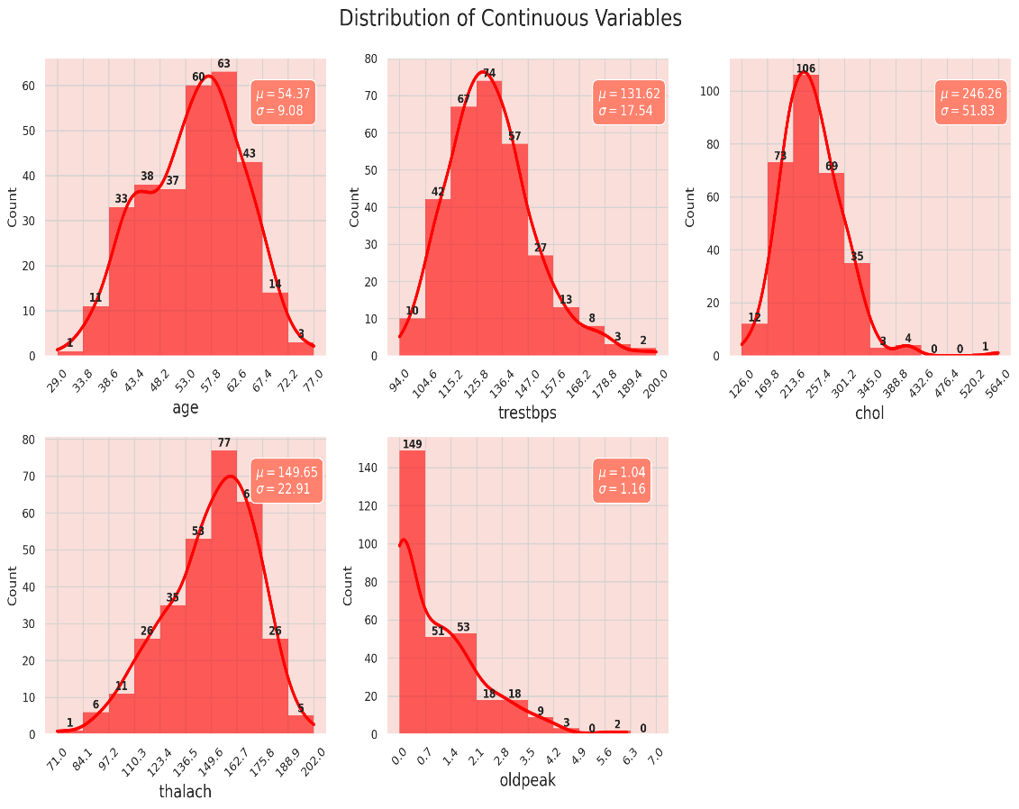
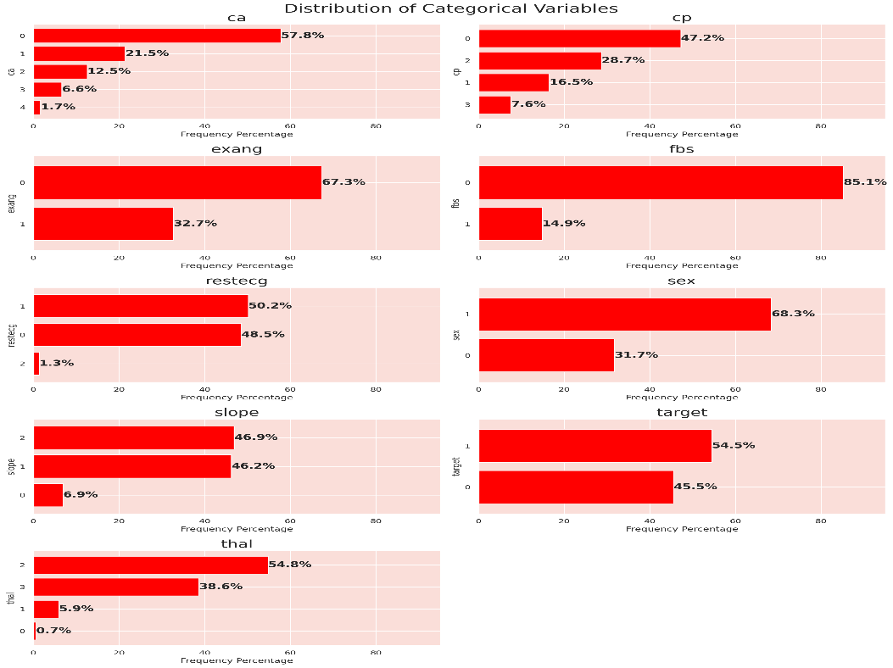
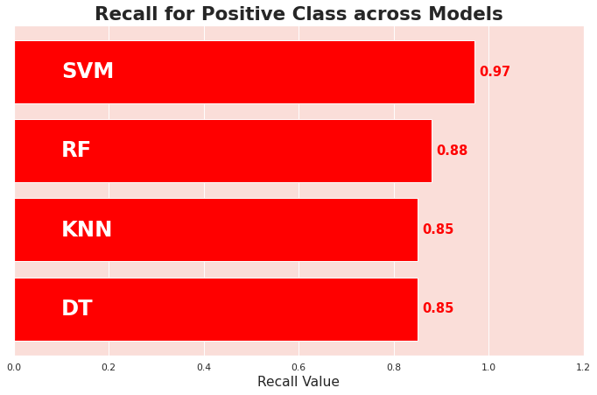
RESULTS:

